Slide 1
A Very Basic Fiber Optic Tutorial
(Not A Dummy’s Guide to Fiber Optics!)

Slide 2
What Is Fiber Optic Cable Made From
Optical fibers are made of extremely pure optical glass. We think of a glass window as transparent, but the thicker the glass gets, the less transparent it becomes due to impurities in the glass.
If you were on top of an ocean that is miles of solid core optical fiber glass, you could see the bottom clearly.

Slide 3
BENEFITS OF FIBER OPTICS
High bandwidth for voice, video and data applications
Optical fiber can carry thousands of times more information than copper wire.
For example, a single-strand fiber strand could carry all the telephone conversations in the United States at peak hour.
Fiber is more lightweight than copper. Copper cable equals approximately 80 lbs./1000 feet while fiber weighs about 9lbs./1000 feet
Low loss. The higher frequency, the greater the signal loss using copper cabling. With fiber, the signal loss is the same across frequencies, except at the very highest frequencies (not really 100% true)
Reliability - Fiber is more reliable than copper and has a longer lifespan
Secure - Fiber does not emit electromagnetic interference and is difficult to tap (but not impossible to tap)

Slide 4
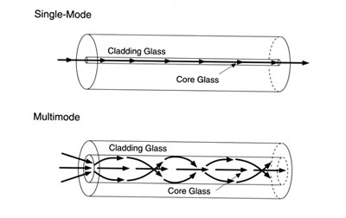
Types of Fiber Optic Cables
Multimode: Used for short distances up to 2km
Single-mode: Used for distances up to 70km

Slide 5
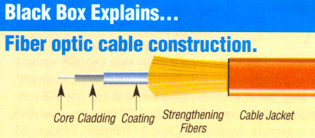
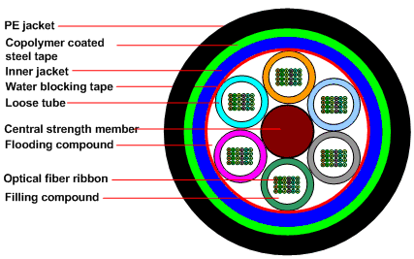
Different Types of Cable Construction
Loose Tube
High Capacity Ribbon

Slide 6
Fiber Nanometer Frequencies (single-mode)
Attenuation depends on the fiber type and the wavelength. If the absorption spectrum of a fiber is plotted against the wavelength of the laser, certain characteristics of the fiber can be identified.
The graph in Figure 2 illustrates the relationship between the wavelength of the injected light and the total fiber attenuation. The OH-symbol identified in the graph indicates that at the 950,1244,and 1383nm wavelengths, the Presence of hydrogen and hydroxide ions within the fiber optic cable causes an increase in attenuation.
These ions occur because water molecules either entered the cable material through a chemical reaction during the manufacturing process or as environmental humidity. The water molecules are known as the water peak absorption areas.

Slide 7
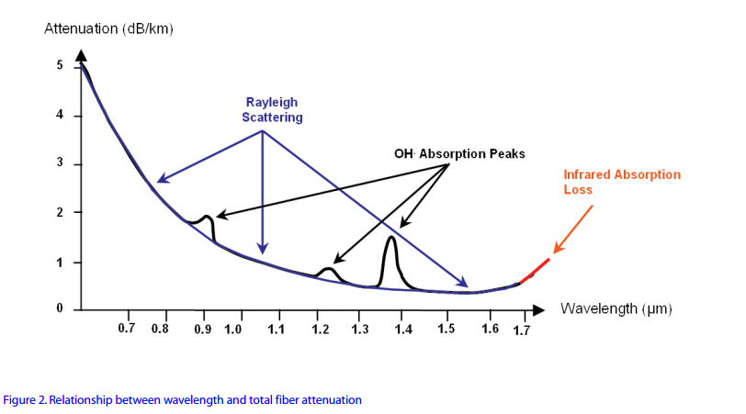
Frequency Response of Fiber Optic Cable

Slide 8
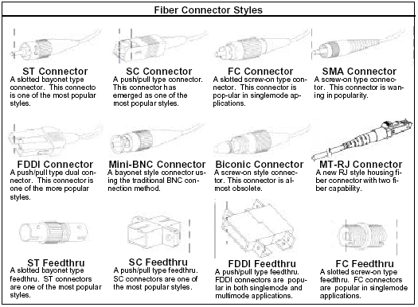
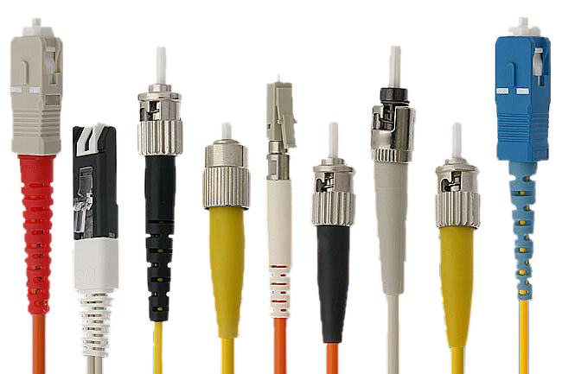
Connector Types

Slide 9
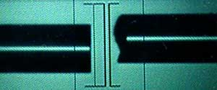
Automated Splicing 1 of 5
(Fusion Splicing)
The splicer will show the fibers being spliced on the video screen.
Fiber ends will be inspected for proper cleaves and bad ones like the one on the right above will be rejected.

Slide 10
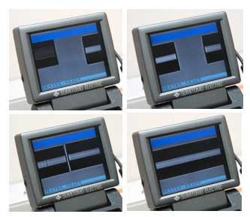
Automated Splicing 2 of 5

Slide 11
Automated Splicing 3 of 5
Fibers will be moved into position, refuse cycle will remove any dirt on the fiber ends and preheat the fibers for splicing.
The fibers will be aligned using core alignment method for that splicer.
The fibers will be fused by an automatic arc cycle that heats them in an electric arc and feeds the fibers together at a controlled rate.
When fusion is completed, the splicing machine will inspect the splice and estimate the optical loss of the splice. It will tell the operator if a splice needs to be remade.

Slide 12
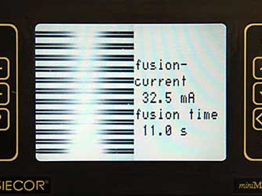
Automated Splicing 4 of 5
(Ribbon cable splicing)
320X for single X or Y view, or 200X for X and Y view

Slide 13
Problems Associated with Fiber
Micro bends (bending radius is higher than allowed.
Cable twisted during installation causes spikes in attenuation
High splice attenuation (anything greater than 0.1db is considered bad)
Connector mating issues: causes higher attenuation and reflections

Slide 14
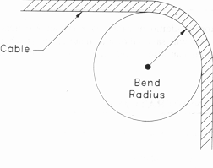
Minimum Bend Radius of fiber
For fiber optic cables not in tension, the minimum bend radius is 10 x diameter; cables loaded in tension may not be bent at less than 20 x diameter. SP-2840A states that no f/o cable will be bent on a radius less than 3.0 cm (1.18-in).

Slide 15
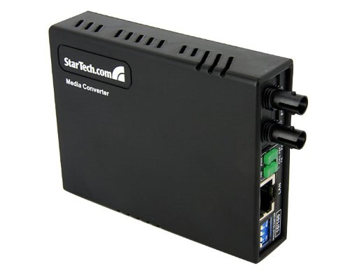
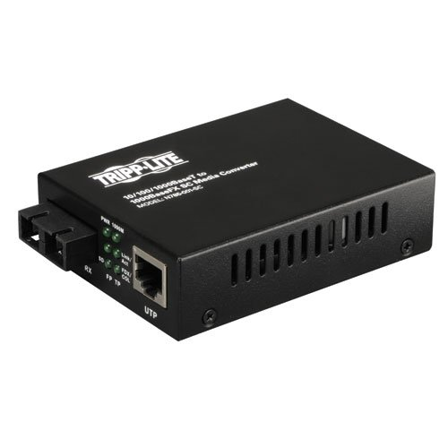
Different Types of Interfaces
StarTech.com 10/100 Fiber to Ethernet Media Converter Multi Mode ST 2 km (MCM110ST2)
$50
TRIPP LITE Fiber Optic Gig Media Converter UTP Gigabit Ethernet to Fiber (N785-001-SC)
$150

Slide 16
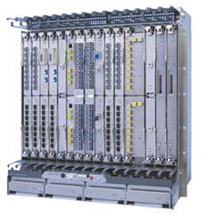
Commercial Equipment
Innovative Features of the FLASHWAVE 9500 Packet ONP
Modular architecture designed for 99.999% availability and dense, cost-effective scaling Industry-leading 100G coherent optics transport technology
Integrated ROADM with 88 wavelengths of 10G, 40G and 100G transport
Centralized Ethernet, SONET/SDH and OTN switch fabric offers any-to-any connectivity and efficient aggregation

Slide 17
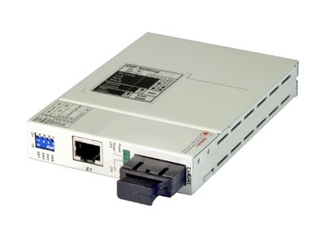
T1 Adapter
Standards: T1: ITU-T G.703, G.704, AT&T TR-62411, ANSI T1.403, Interfaces: RJ48c 100ohm balanced T1 connector and dual SC 155M fiber port
Operating wavelength: 1310nm multimode, Operating distance: 2Km on 62.5/125um fiber, works also on 50/125um fiber, power budget 11dB, Optical connector: SC dual type
$165.00

Slide 18
Fiber Optic Transmission Timing
Stratum Levels
Stratum Level | Free Run Accuracy | Holdover Stability
1 | +/- 1x10^-11 | N/A (Cesium Clock)
2 | +/- 1.6x10^-8 | +/- 1x10^-10 per day
3E | +/- 4.6x10^-6 | +/- 1x10^-8 per day for the first 24 hrs.
3 | +/- 4.6x10^-6 | +/- 3.7x10^-7 per day for the first 24 hrs.
SONET minimum clock | +/- 20x10^-6 | Under Study

Slide 19
WDM
WDM
Achieved through refraction and diffraction technique for combining and separating optical signals of different wave lengths.

Slide 20
DWDM
Dense Wave Division Multiplexing
Closely spaced wavelengths are used.
The current methods are:
    Thin-film filters
    Arrayed Wavelengths
    Diffraction Grating

Slide 21
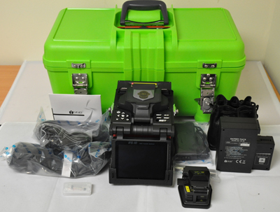
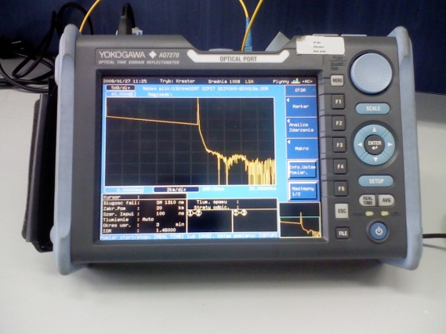
Splicing and Testing Equipment
Fusion Splicer
Optical Time Domain Reflectometer

